Slide 1
UPPER MISSISSIPPI RIVER CONFERENCE 2018
REGIONAL FLOOD COALITIONS
A LOCAL LEVEL APPROACH

Slide 2
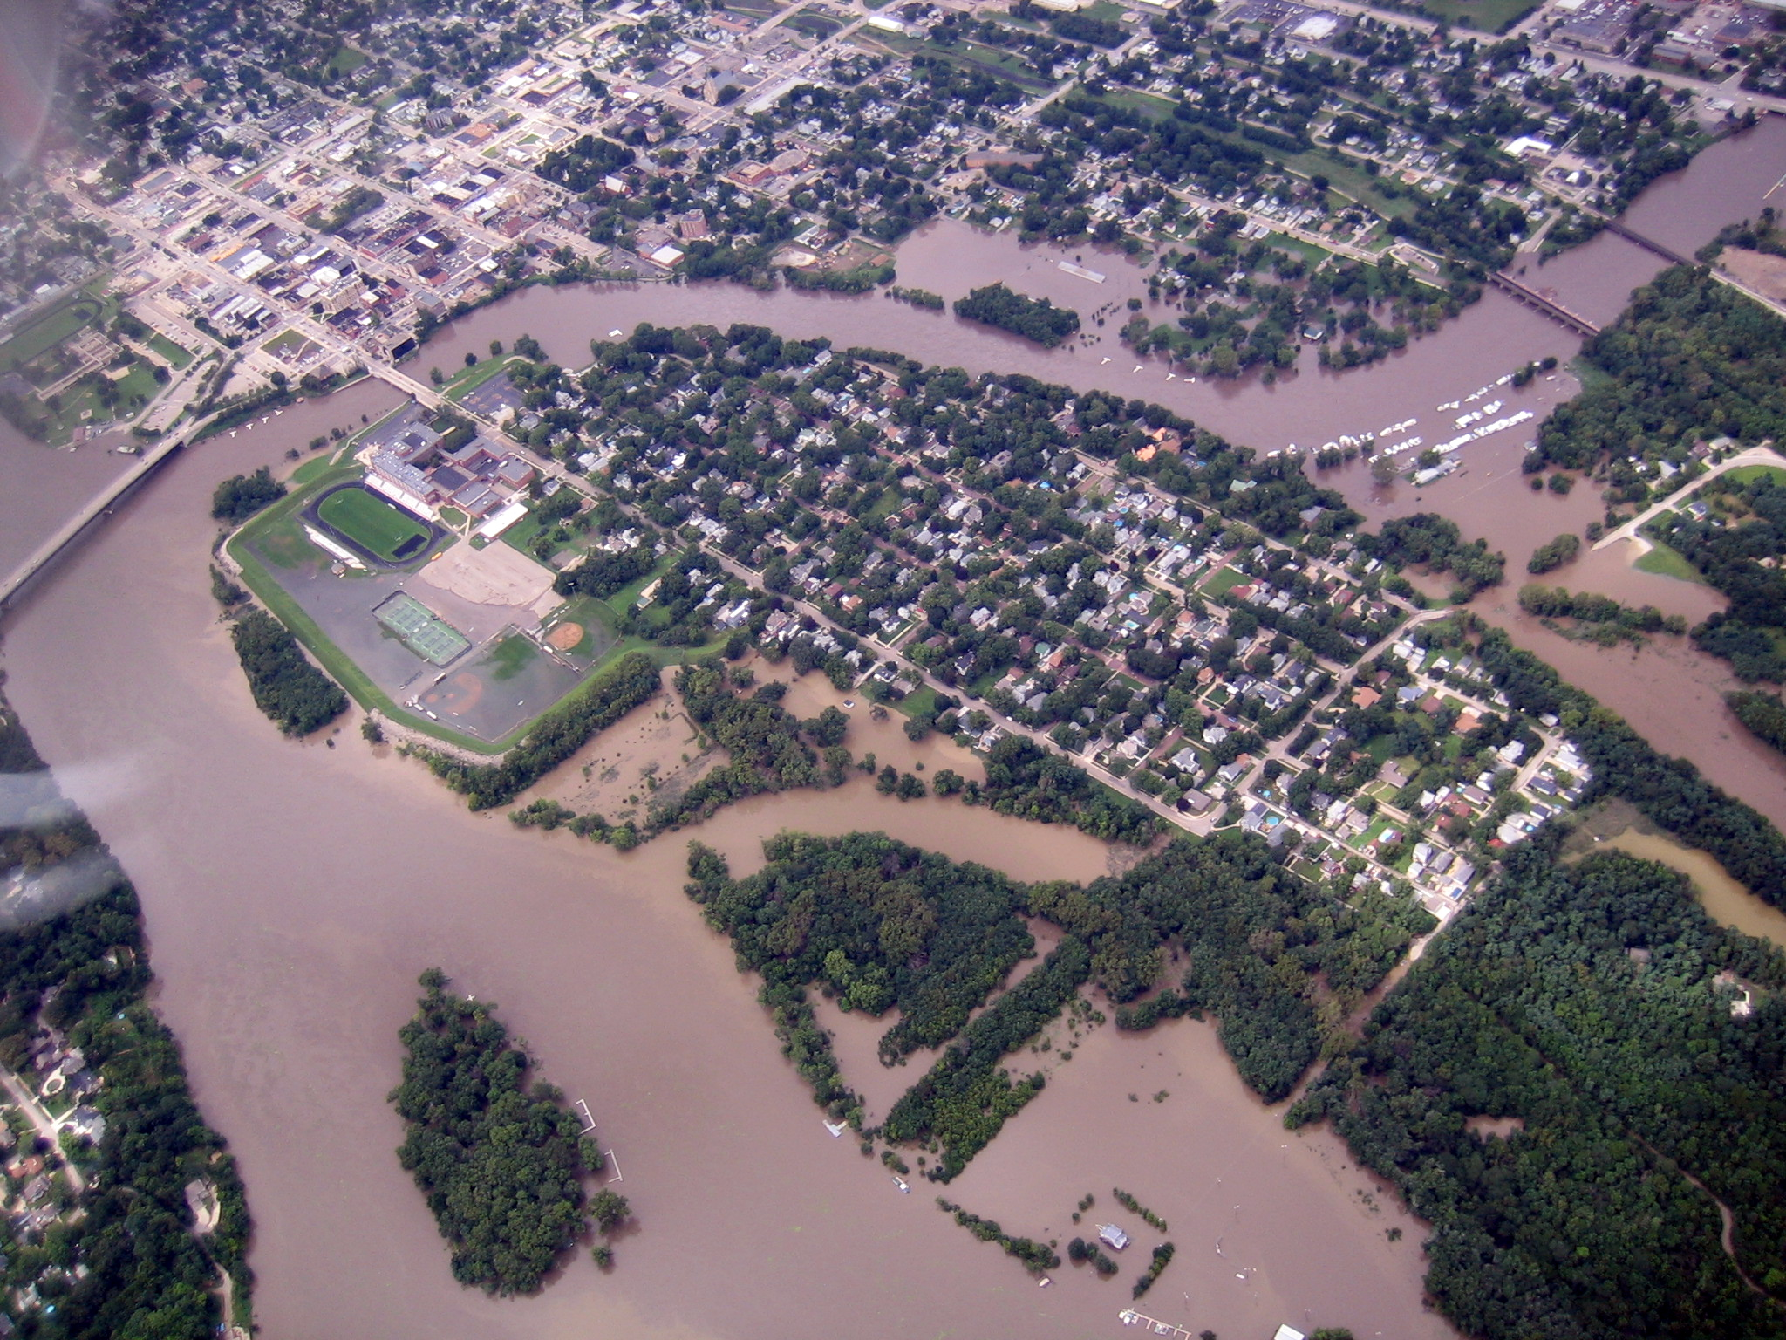
August, 2007
Notes:
A short time after I took the job, I was informed that I am also the FP mgr. This was what I first saw.

Slide 3
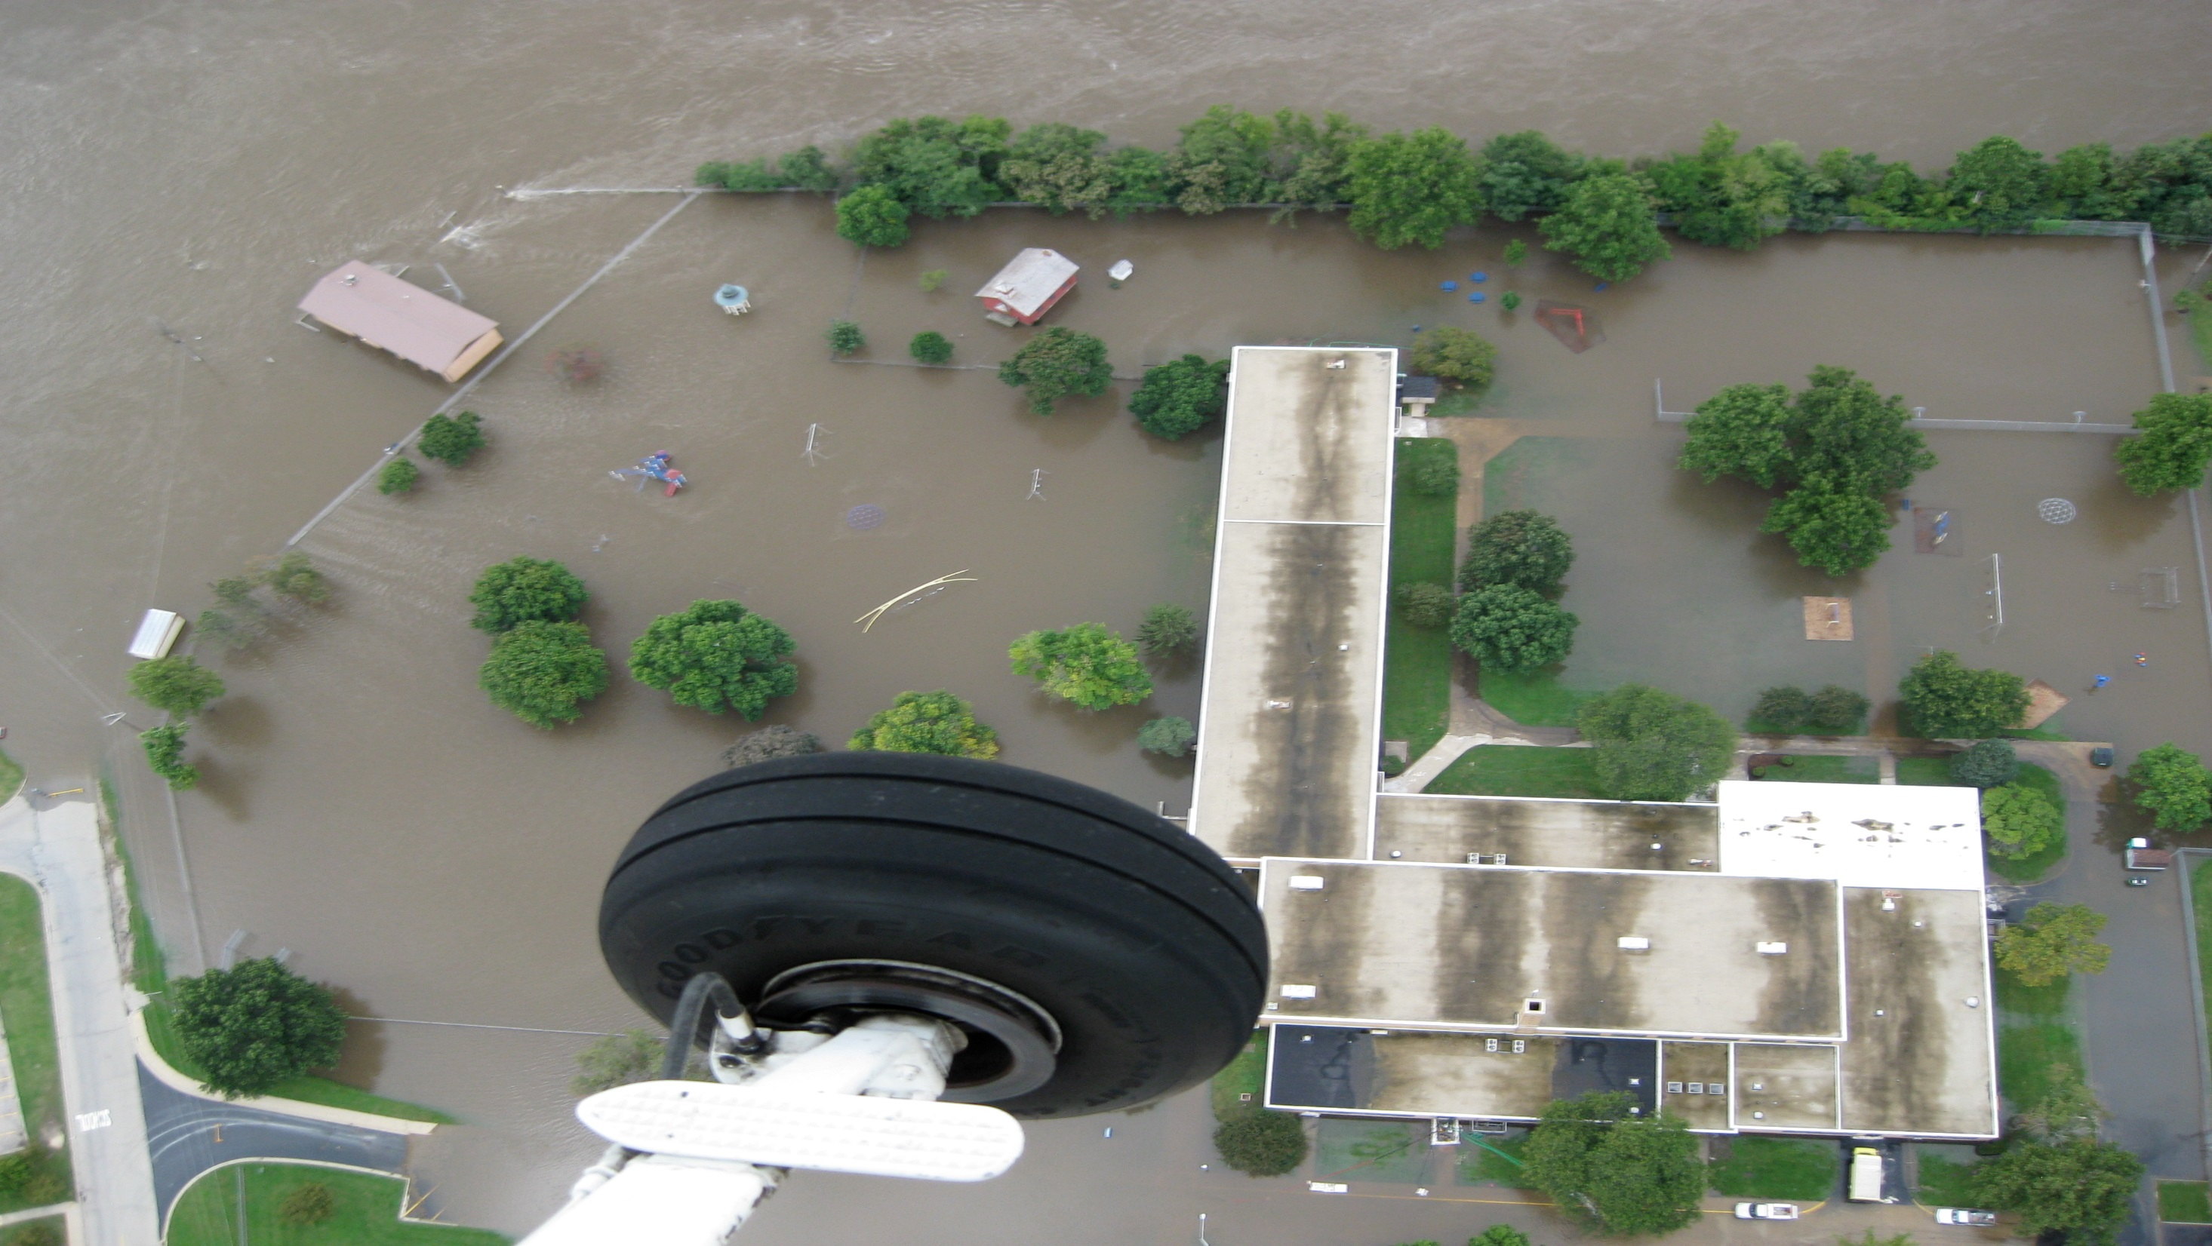

Slide 4
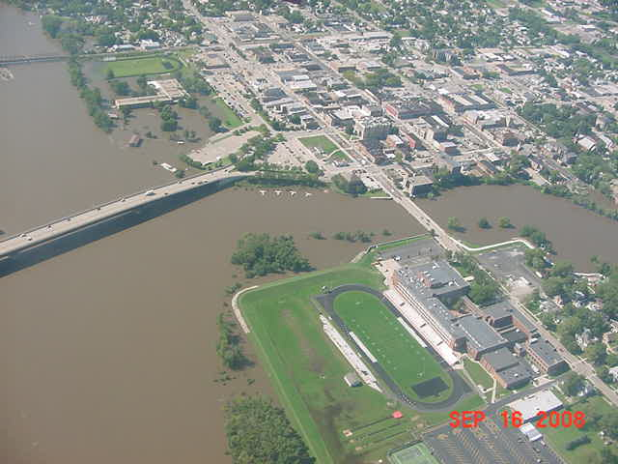

Slide 5
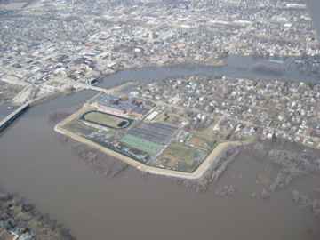
March, 2009

Slide 6
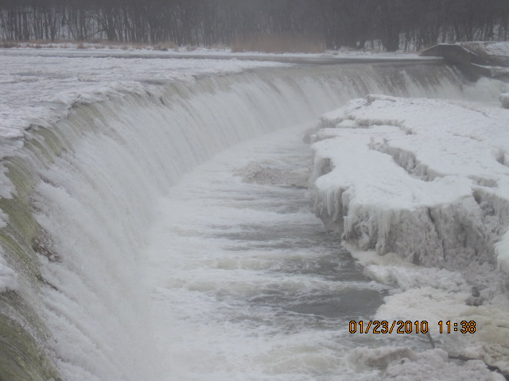

Slide 7
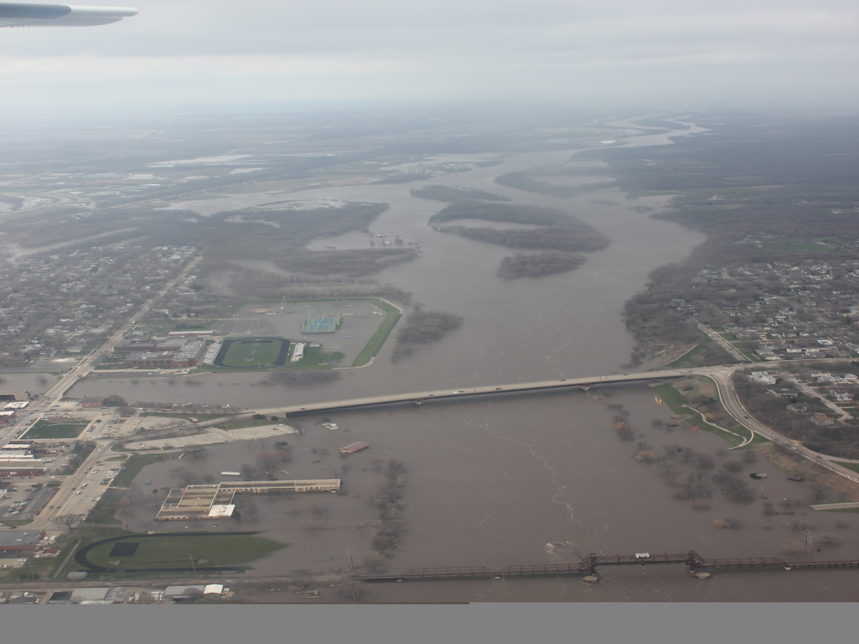
APRIL 19, 2013

Slide 8
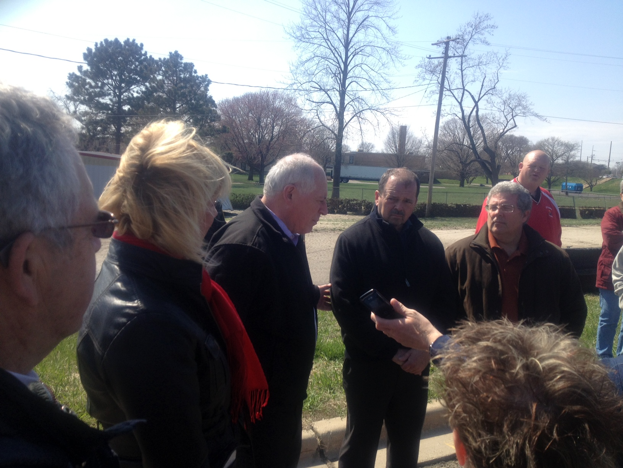
Senator Rezin
APRIL 21, 2013
Governor Quinn
Mayor Eschbach
Rep. Frank Mautino
Notes:
Shortly after the flood waters receded, emergency management and state legislators came to Ottawa.

Slide 9
Welcome Community Leaders from the 38th District
First Organizational Meeting—February 12, 2014
Notes:
Our purpose here today is to empower the citizens of the 38th district with information in order to create a more resilient community and be better prepared for disaster.

Slide 10
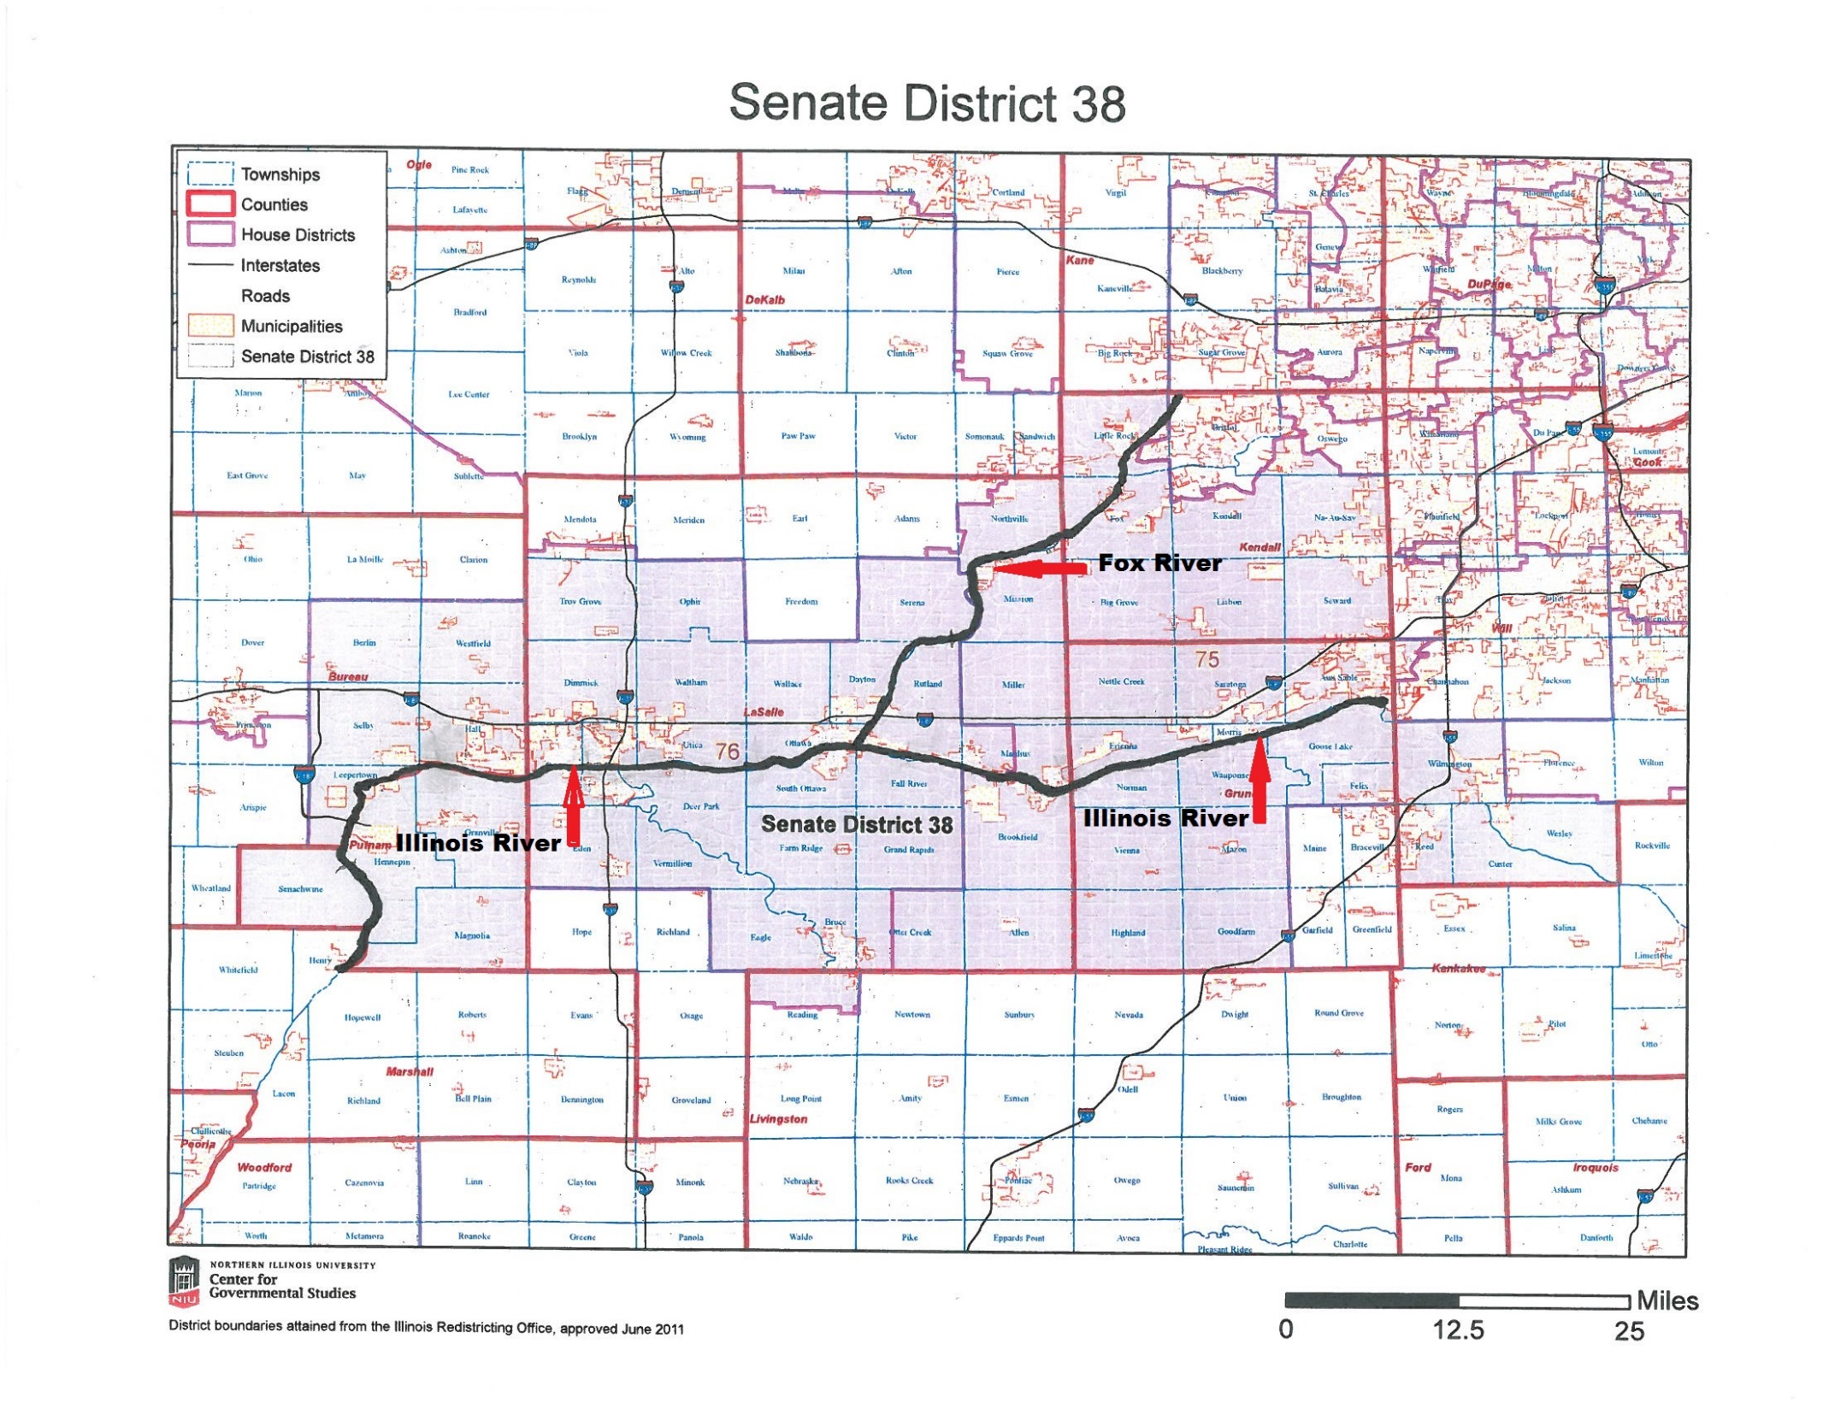

Slide 11
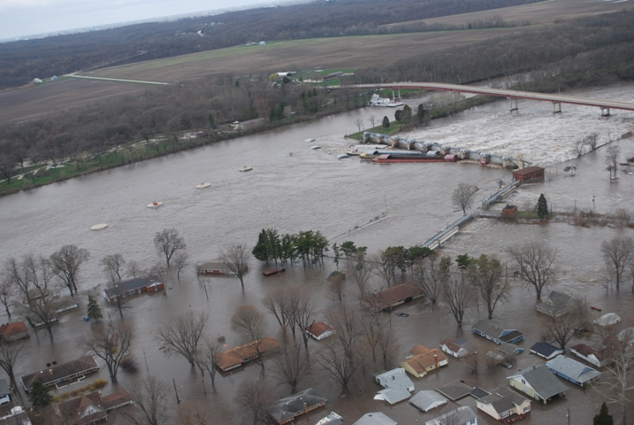
MARSEILLES

Slide 12
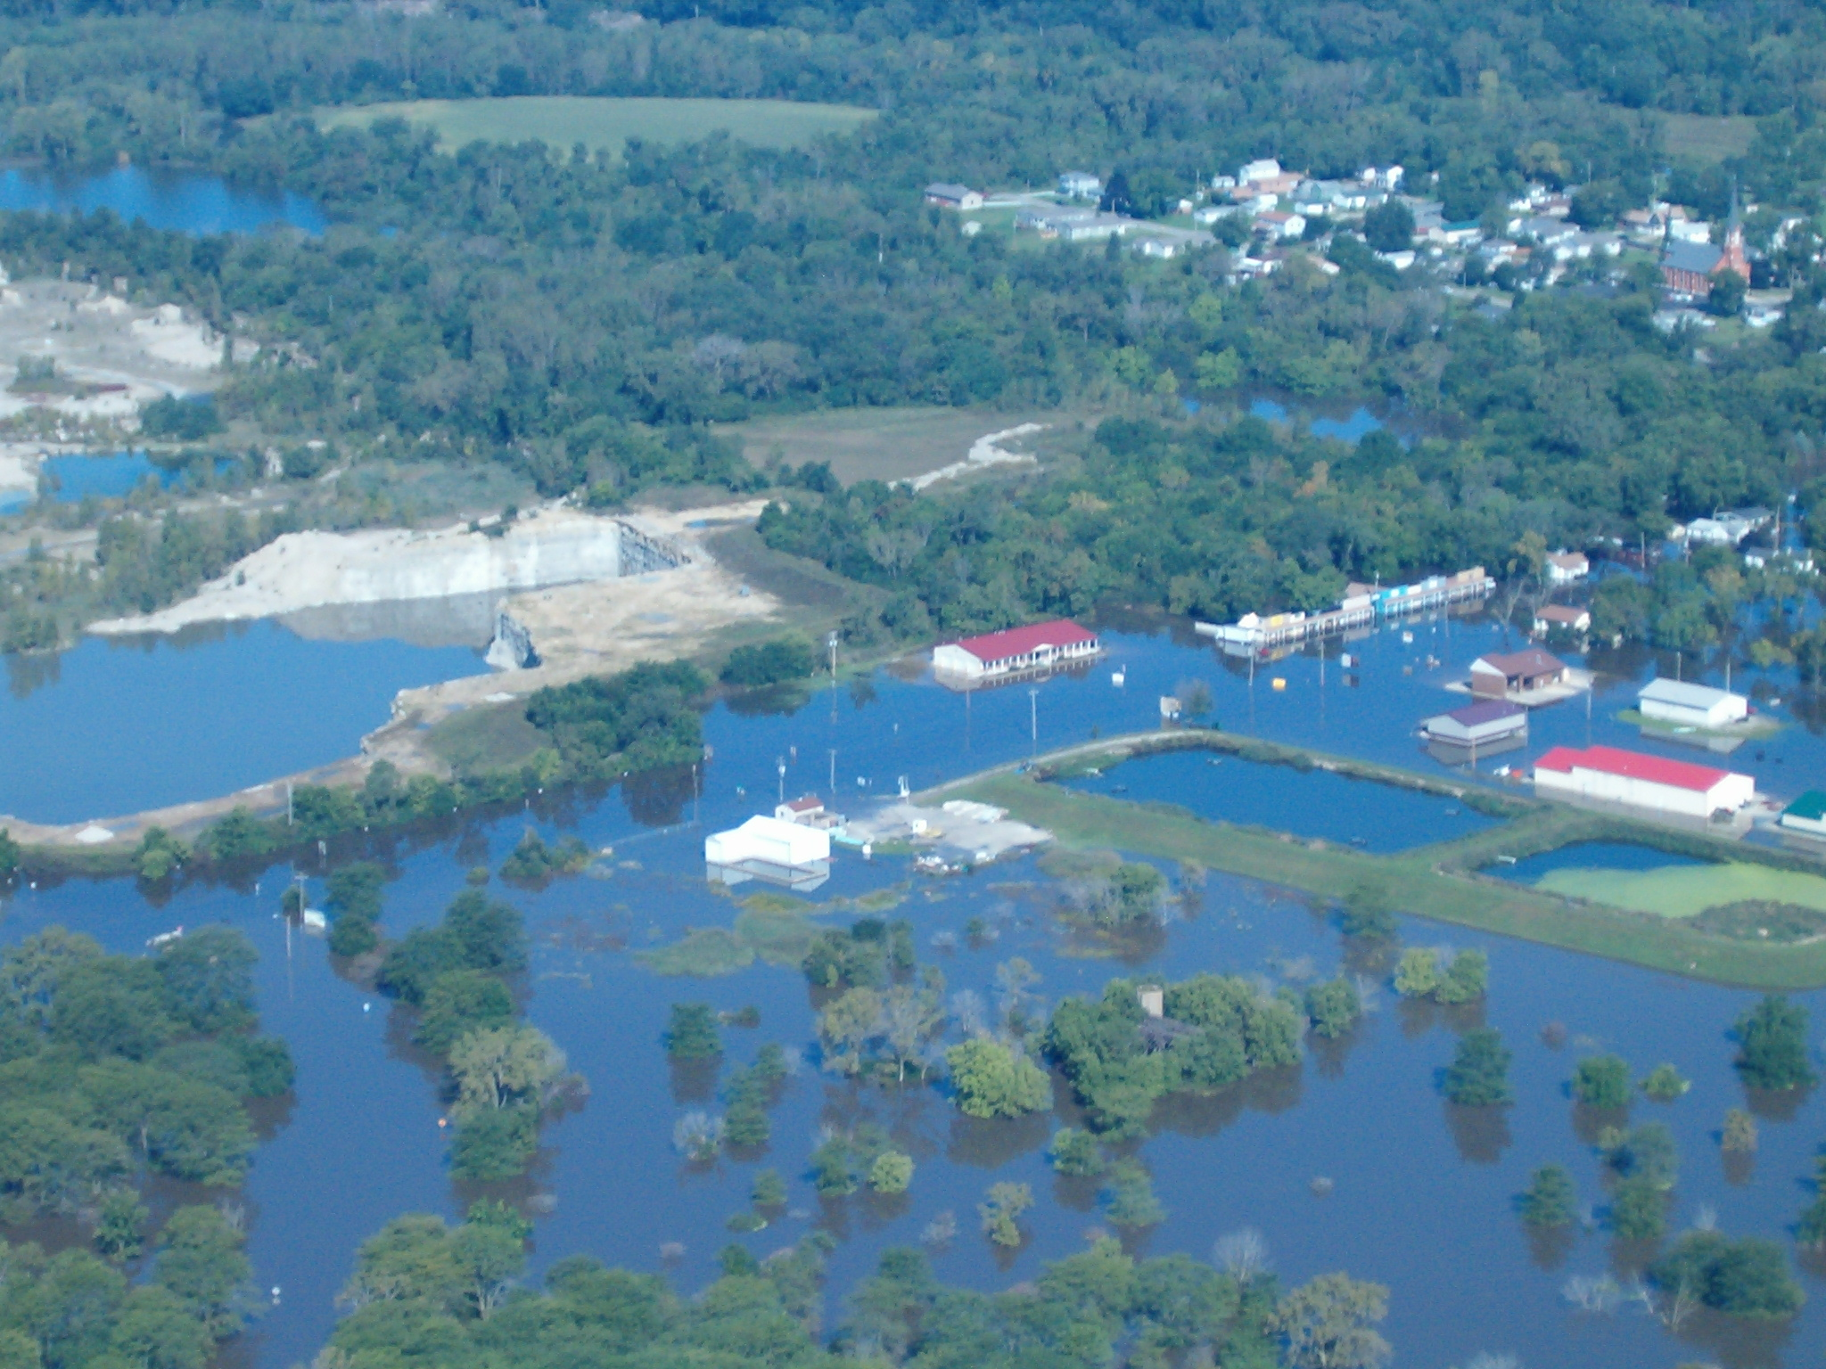
UTICA

Slide 13
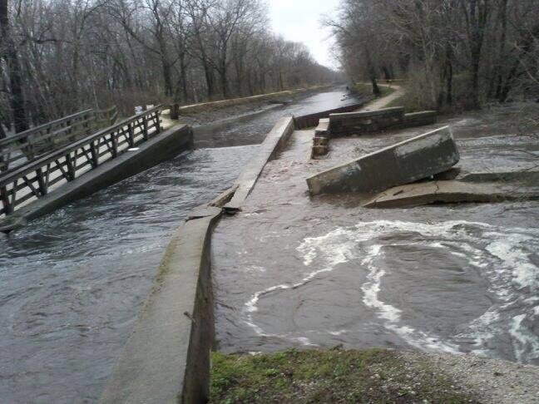
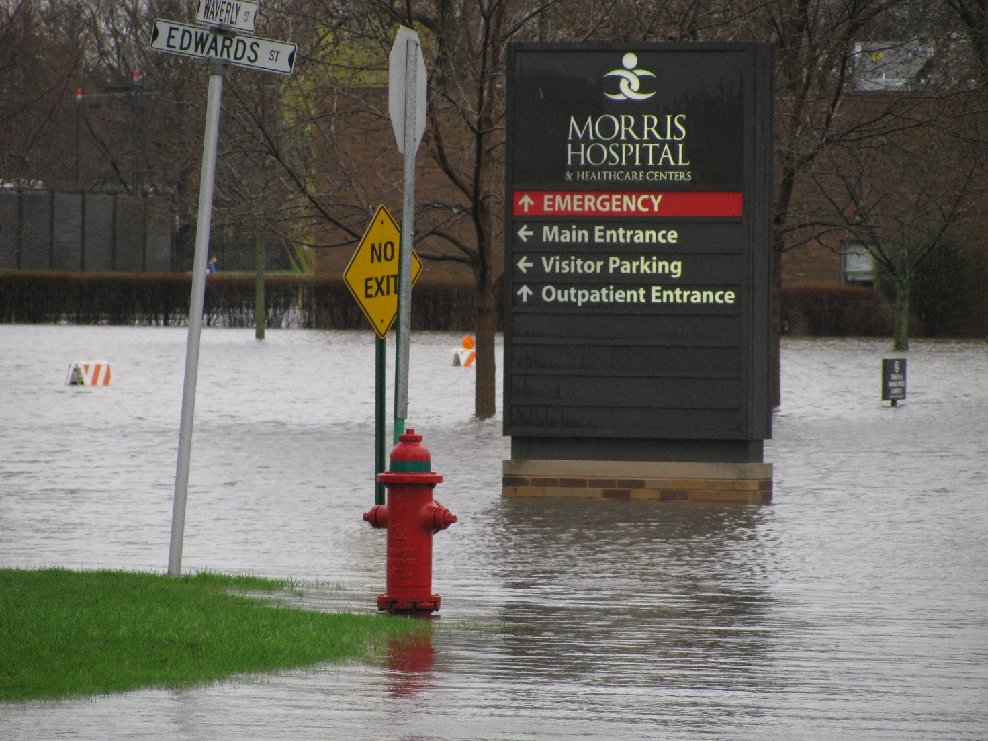
Morris Hospital
Forced Evacuation
2.5 Million in damage
AuxSable Aqueduct
Failure caused hospital to flood

Slide 14
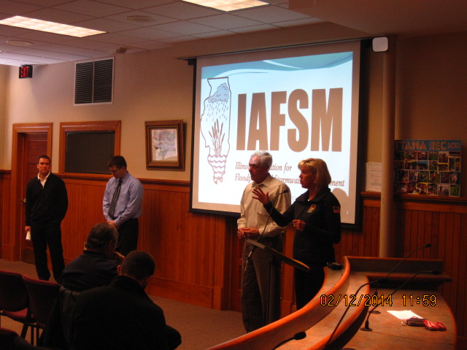
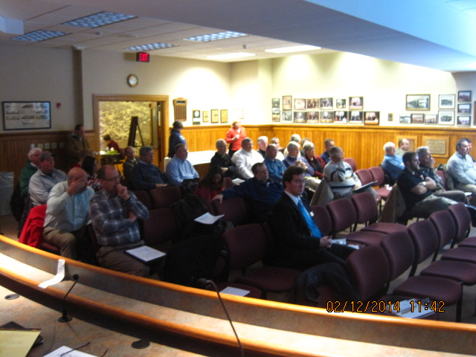
Dear Mayor:
As you well know, your community has recently been affected by flood related damages. The flooding this past spring was disastrous for many communities in the Illinois River watershed, including many in my District. Since that Federal Disaster of April 2013, I have worked with my constituents to identify the challenges that face our flood prone communities. While many of your flood community issues may be complex and seem difficult to resolve, there are technical resources and programs available to help successfully solve and mitigate flood related problems. I have found that the Federal Government, FEMA, Homeland Security, the Insurance Service Office, Illinois Emergency Management Agency and Illinois Department of Natural Resources each have resources to help us deal with the post flood challenges at hand, and to help us prevent flood damages in the future.
In an effort to share information, promote sound floodplain management practices, and save the taxpayer dollars I would like to form a coalition of Illinois River watershed communities. We can learn from one another. Joining together with other communities in similar situations has a synergistic benefit. Some communities in Illinois have had tremendous success in mitigating flood losses and we can collectively learn from their experiences. Ottawa, Illinois, in the late 1990’s was one of the worst repetitive loss communities in the State. Today that community has eliminated much of their flood risk and is ranked at the top of the Community Rating System which allows their citizens the benefit of a 25% discount on flood insurance premiums.
The Illinois Department of Natural Resources, Office of Water Resources, The U.S. Army Corps of Engineers, the Illinois Association of Floodplain and Stormwater Managers and the City of Ottawa have all agreed to assist my office in the formation of a coalition of flood prone communities in my district. To that end I am asking your participation in this endeavor. I am proposing that we have an initial formational meeting on February 12, 2014. The City of Ottawa has offered the use of their Council Chambers.

Slide 15
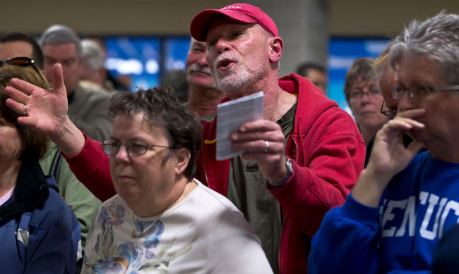
Education and Outreach
Seek state programs & staff
Solicit private sector investment
Find not-for-profits
Package programs – leverage power!
Encourage local ownership
New technologies
Think outside the box

Slide 16
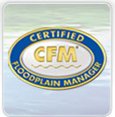

Slide 17
The Community Rating System
(CRS)
Basics
Creditable Activities
How To Join
Local Participation

Slide 18
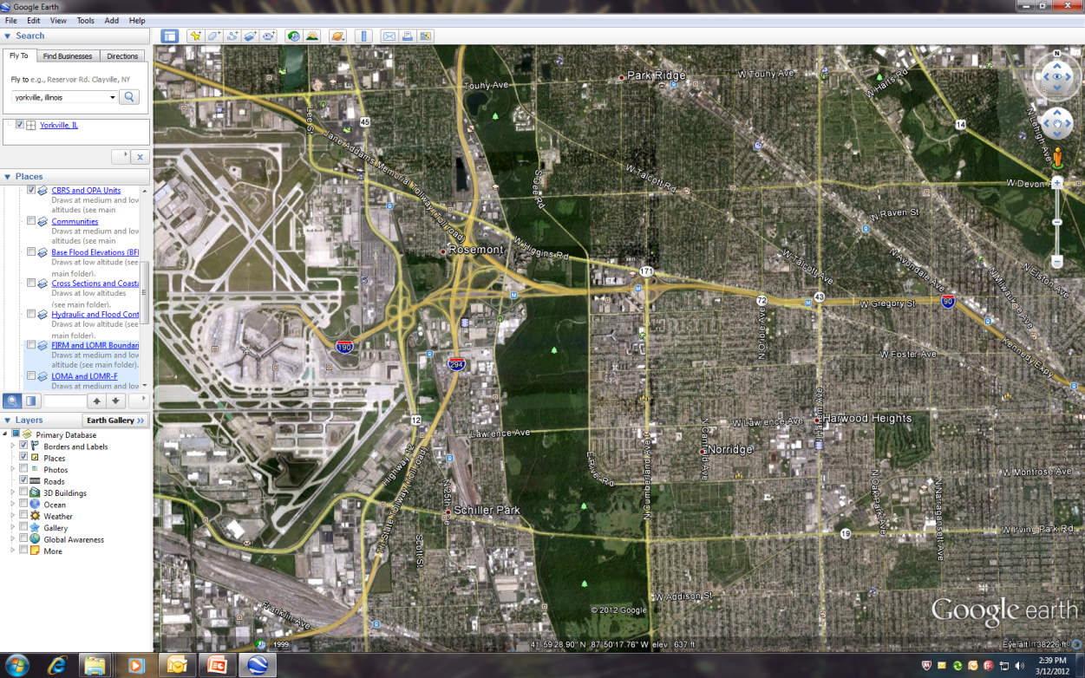
Going Above and Beyond
Restrictive floodway.
Appropriate uses only. No buildings!
Stormwater regulations (detention/retention).
Compensatory storage required (1 : 1.5)
Freeboard
Cumulative sub dam
Restrictive zoning.
Countywide ordinances.

Slide 20
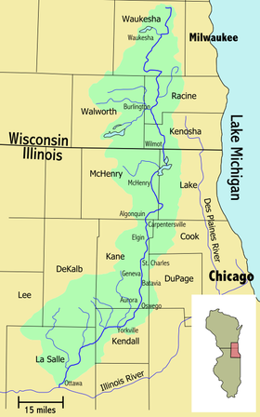
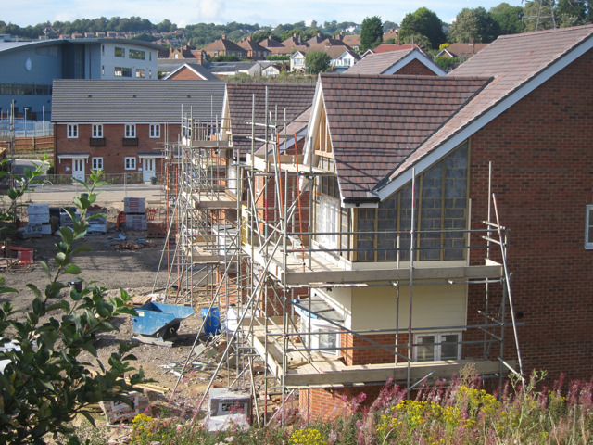
Fox River Watershed

Slide 21
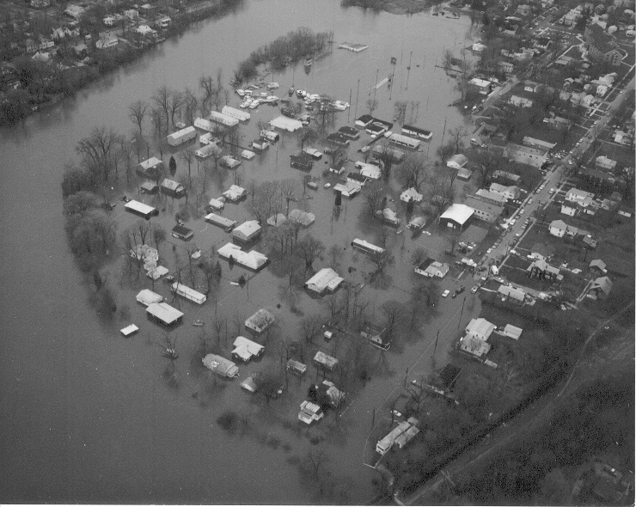
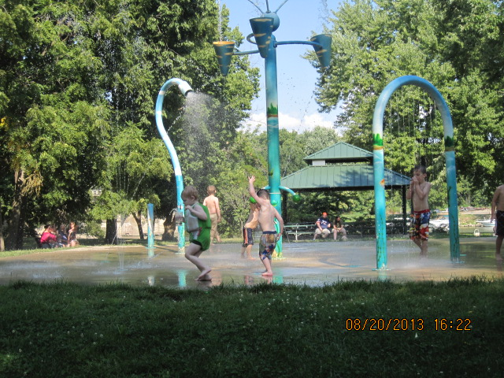
Today
1984

Slide 22
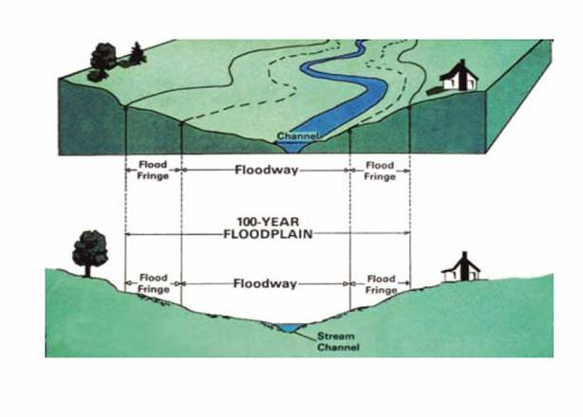

Slide 23
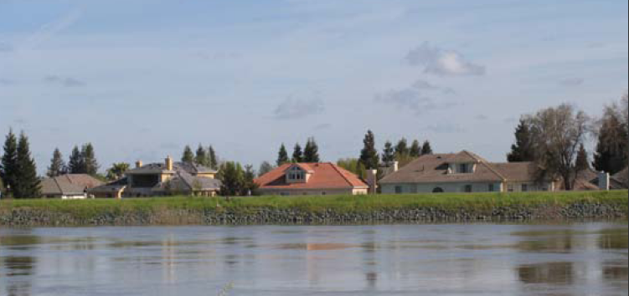
You Live Behind a Levee How Safe are You From Floods?
Levees are built to reduce flood risk, but…
What does it mean to live behind a levee?
How much protection does a levee provide?
What should you know to remain as safe as possible

Slide 24
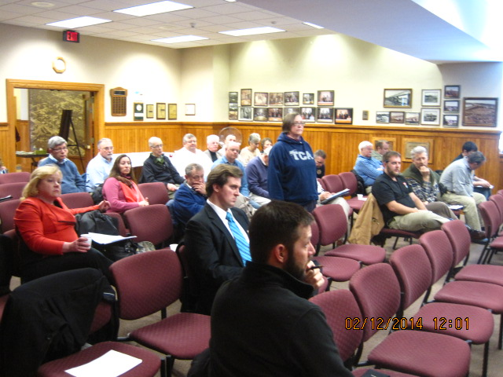
Mitigation Hit List
Marseilles Waste Water Treatment Plant
Peru Waste Water Treatment Plant
Ottawa Waste Water Treatment Plant
LaSalle (City) Waste Water Treatment Plant Water Treatment Plant
Tonica Waste Water Treatment Plant
DuPue Waste Water Treatment Plant
Utica Waste Water Treatment Plant, Village Hall, Public Works
LaSalle County Nursing Home

Slide 25
Waste Water Treatment
School
Police Station/Village Hall
Hospital
Township High School
County Nursing Home

Slide 26
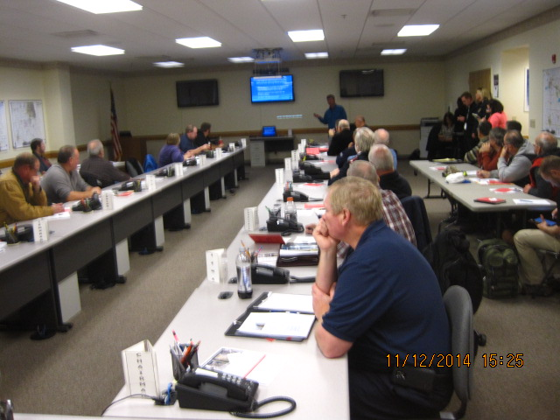
IDNR, Office of Water Resources.
US Army Corps of Engineers
“Flood Fighting”
Hands on demo from vendors
Hesco Systems
Dam Bag

Slide 27
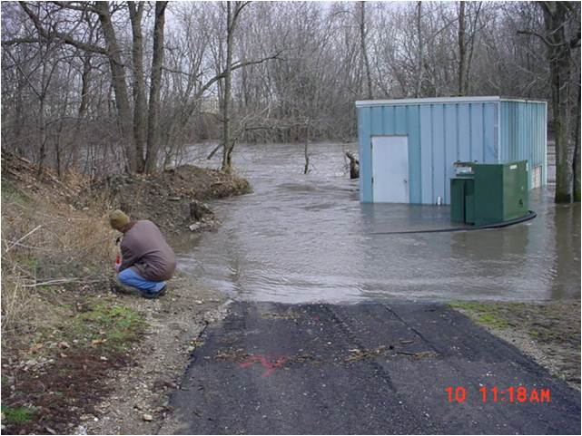
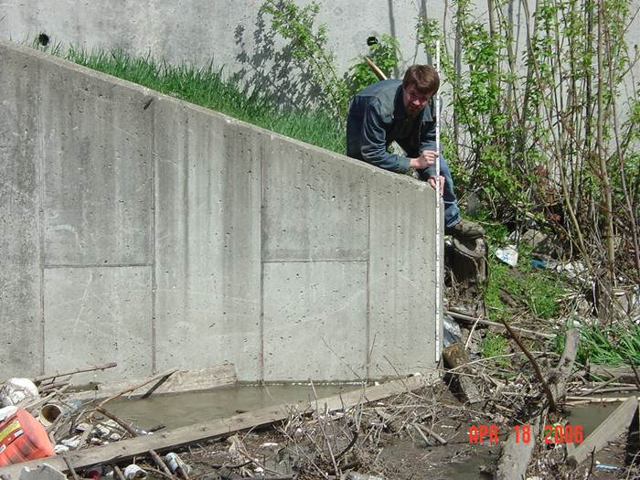
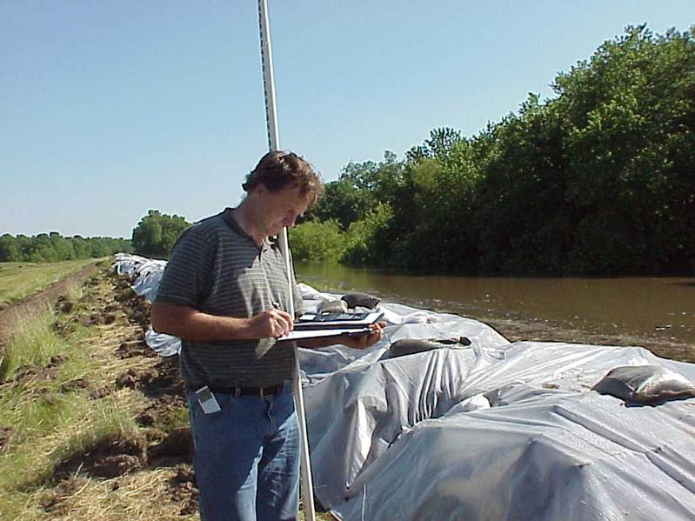
Office of Water Resources Flood Surveillance Activities
IL Department of Natural Resources Office of Water Resources
William B. Milner Jr, P.E., CFM
Project Engineer
Provide IEMA with daily updates during the flood event
Provide technical guidance to IEMA to assist in their flood fighting operations
Perform flood surveillance operations in the field to gather information concerning the flood event
Operate Stratton Lock & Dam and Algonquin Dam to minimize flooding upstream in the Chain O’ Lakes and downstream on the Fox River
Maintain a record of flood impacts for the streams in Illinois
Document individual flood events

Slide 28
US Army Corps of Engineers
Agenda
▪ Flood Fighting Methodology
▪ Flood Fighting Structures
▪ Surveillance and Inspections
▪ Common Failure Modes
▪ Providing Technical Assistance
▪ Recovery of Resultant Flood Issues

Slide 29
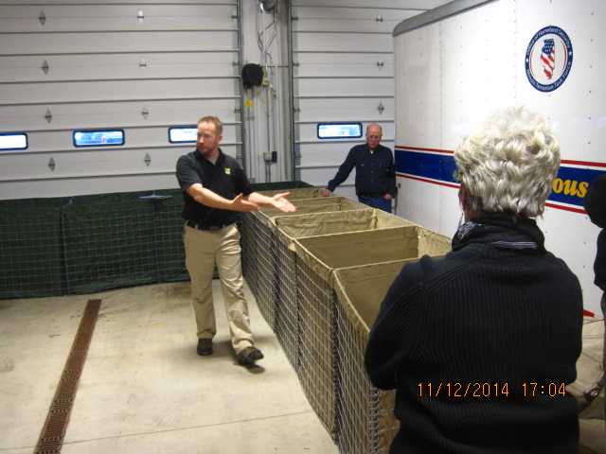
Rapidly deployed sand wall system

Slide 30
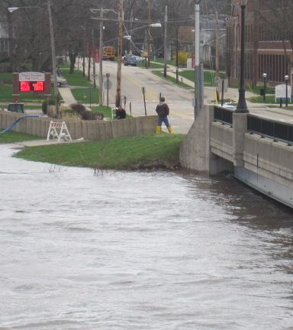
Hesco Sandwall System

Slide 31
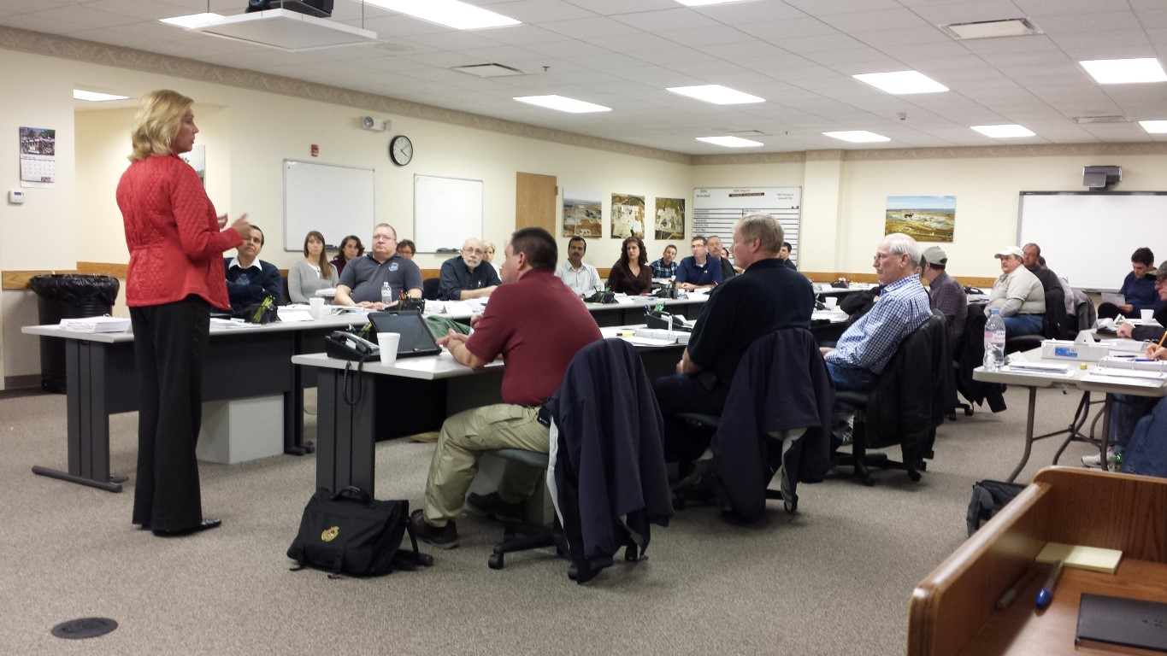

Slide 32
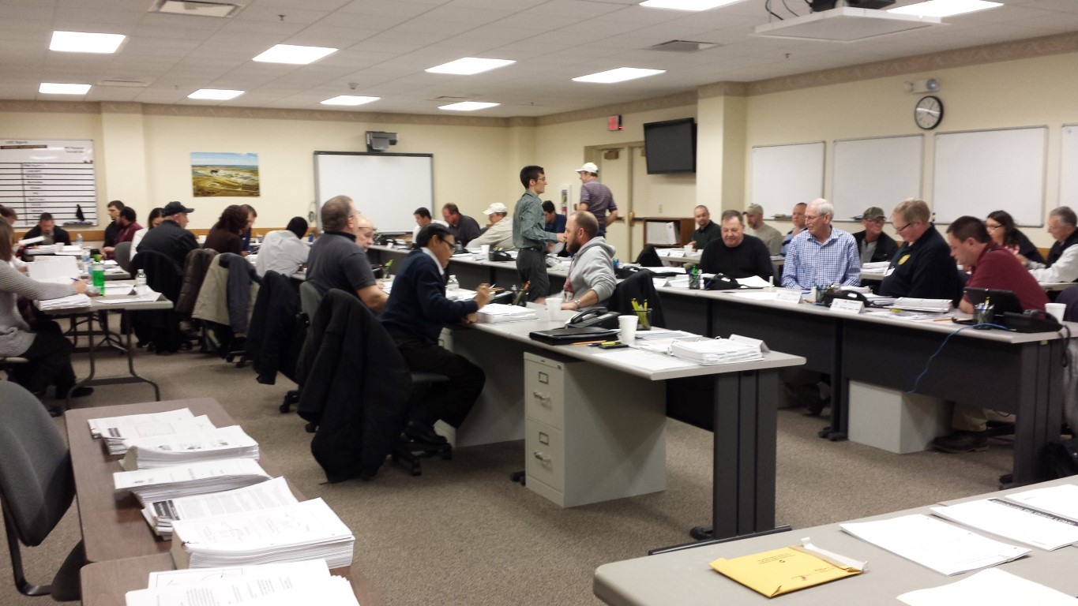

Slide 33
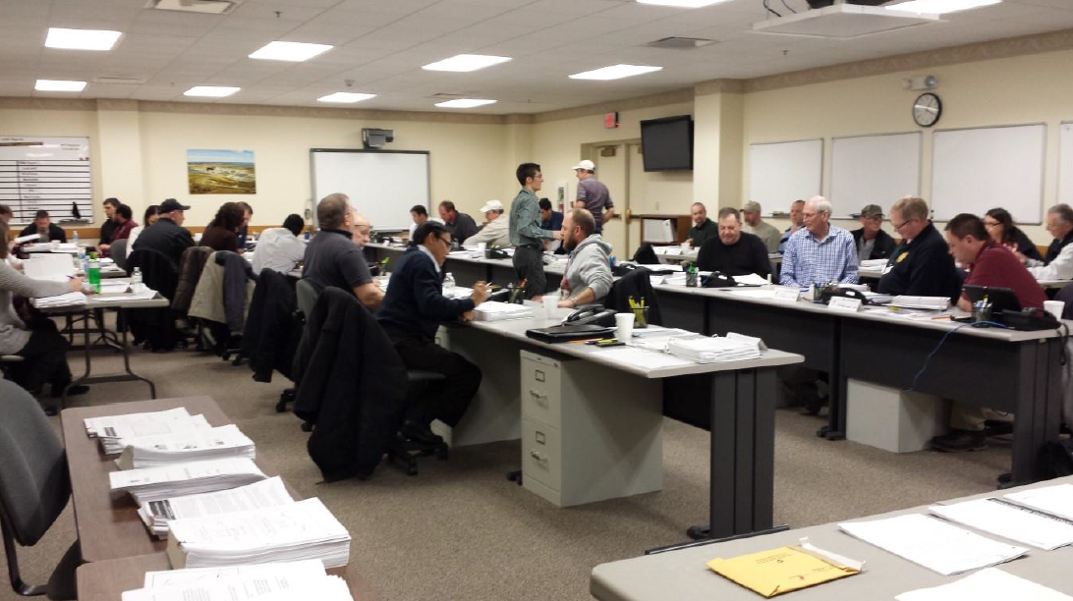
Implement Plan
Illinois Valley Flood Resiliency Alliance Accomplishments:
The Alliance of LaSalle, Grundy, Bureau, Kendall, and Putnam counties has developed an informal resiliency plan for the region
Alliance members meet quarterly to discuss best practices and strategies for flooding
Floodplain 101 and Elevation Certificate training conducted by the Illinois Office of Water Resources
Mitigation grant training conducted by the Illinois Emergency Management Agency and Northcentral Illinois Council of Governments
Floodplain mapping techniques by the University of Illinois / State Water Survey
Flood Fighting School by the U.S. Army Corps of Engineers
HAZUS tool and LiDAR acquisition by the University of Illinois

Slide 34
Implement Plan
Illinois Valley Flood Resiliency Alliance Accomplishments (continued):
Towns in the area are working on flood damage prevention ordinances that would fit their specific needs, restrictive zoning, and storm water regulations
24 new Certified Floodplain Managers in the 38th Senate district
Good relationships and friendships between IVFRA, Federal Government, and leaders in flood prevention
Mike Sutfin (City of Ottawa, IVFRA leader) on a federal Homeland Security task force interested in the outcome of this regional alliance and may potentially extend this model on a national level.
The U.S. Army Corps of Engineers secured Silver Jackets funding to assist the IVFRA in (a) documenting and building upon their action plan and (b) creating a template so that this concept can be replicated, scaled, and shared in other regions

Slide 35
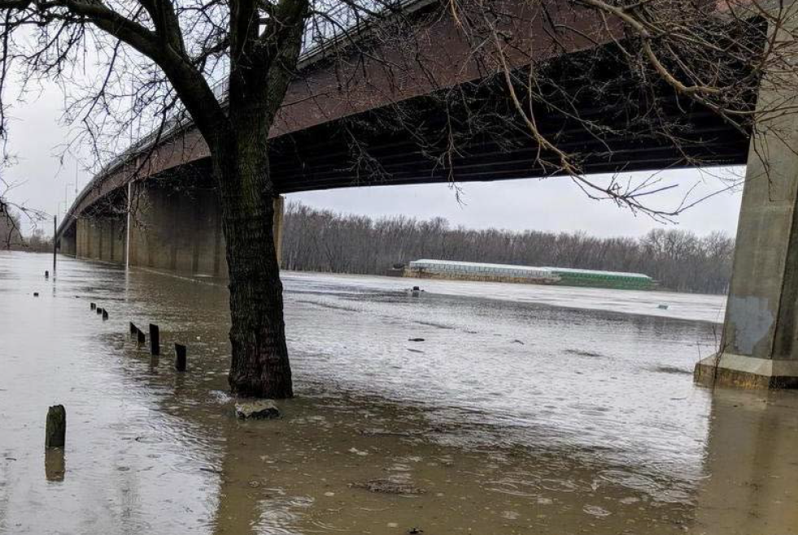
Results of IVFRA: The Illinois valley flood resiliency alliance has produced Measurable benefits for Member communities and the surrounding area
www.morrisherald-news.com

Slide 36
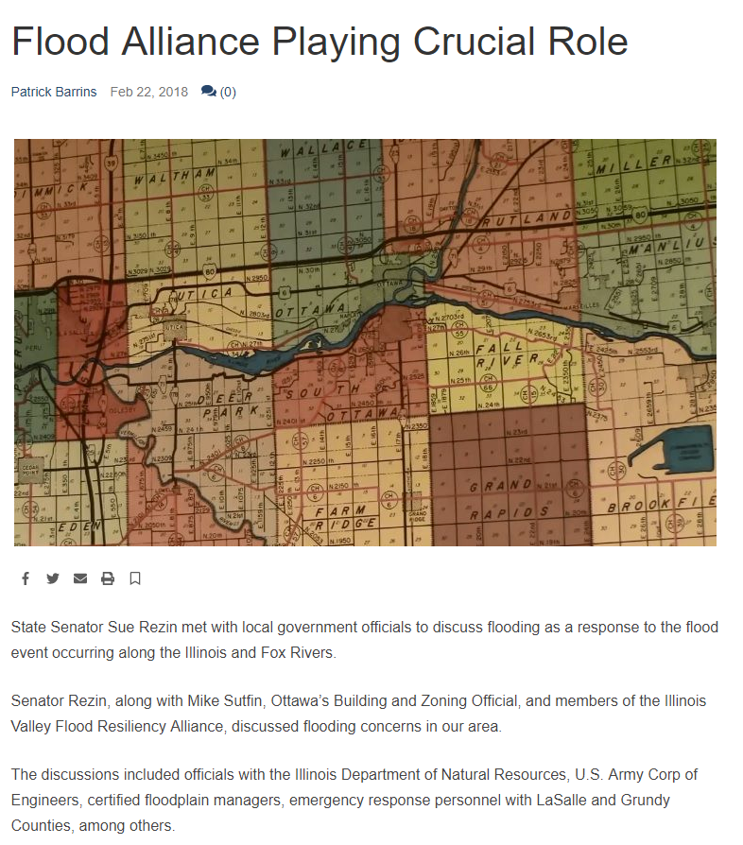
Results of IVFRA
Measurable benefit #1: Improved communication during February 2018 high water event response
“Senator Rezin, along with Mike Sutfin, Ottawa’s Building and Zoning Official, and members of the Illinois Valley Flood Resiliency Alliance, discussed flooding concerns in our area.”
“The discussions included officials with the Illinois Department of Natural Resources, U.S. Army Corp of Engineers, certified floodplain managers, emergency response personnel with LaSalle and Grundy Counties, among others.”
-wcsjnews.com

Slide 37
Results of IVFRA
Measurable benefit #2: University of Illinois HAZAS survey in City of Ottawa estimated return on investment and cumulative losses avoided from buyout structures since 1996.
ROI: 196%
Cumulative losses avoided: $9,565,303
Year of Flood Event | Structures with Potential Losses Avoided² | Cumulative Total Losses Avoided (Estimated)¹ | Cumulative Project Investment¹ | ROI
1998 | 6 | $174,029 | $1,915,702 | 9%
1999 | 1 | $177,005 | $2,911,012 | 6%
2001 | 3 | $184,721 | $4,051,154 | 5%
2002 | 12 | $387,573 | $4,051,154 | 10%
2004 | 1 | $390,954 | $4,051,154 | 10%
2005 | 18 | $661,207 | $4,051,154 | 16%
2007 | 46 | $1,532,380 | $4,051,154 | 38%
2008 | 54 | $3,807,223 | $4,051,154 | 94%
2009 | 47 | $4,881,644 | $4,051,154 | 121%
2013³ | 58 | $7,464,363 | $4,879,545 | 153%
2015 | 20 | $7,746,883 | $4,879,545 | 159%
2017 | 4 | $7,807,273 | $4,879,545 | 160%
2018 | 61 | $9,565,303 | $4,879,545 | 196%
Total |  | $9,565,303 | $4,879,545 | 196%
McVay, B., Hanstad, C., and McConkey, S. “Estimating the Return on Investment of Buyouts: Loss Avoidance Study for the City of Ottawa, Illinois” PowerPoint presentation, Illinois State Water Survey, University of Illinois, 2018.

Slide 38
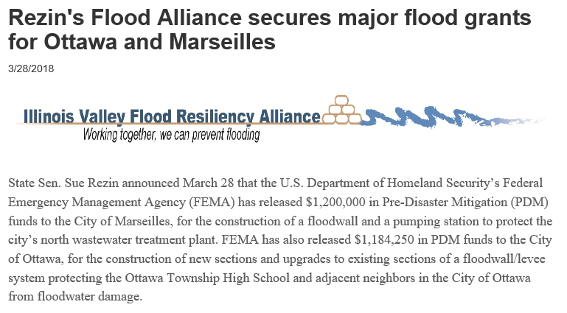
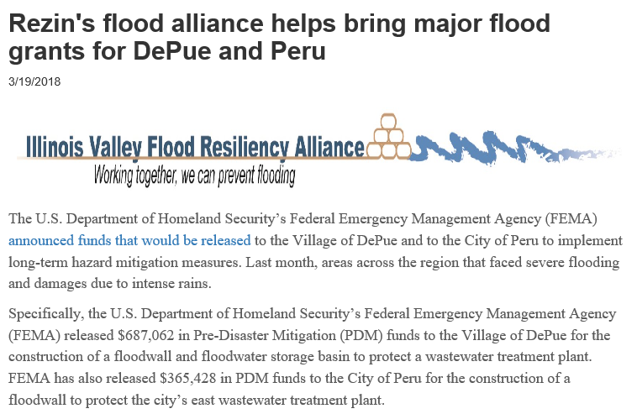
Results of IVFRA
Measurable benefit #3: Clear goals, collaboration, communication, and planning have brought federal grant money into local IVFRA communities.
“‘Out of 12 communities that received federal dollars, four of them are members of our Illinois Valley Flood Resiliency Alliance,’ State Sen. Sue Rezin said. ‘That speaks volumes to the values of our Flood Alliance. These are the positive things that can happen when we work together as one group.’”
-www.senatorrezin.com/News

Slide 39
Results of IVFRA
Measurable benefit #4: Nearby communities are interested in forming their own flood coalitions
State Senate district 37
State Senate district 53
Quad Cities River Action

Slide 40
Points of contact
Mike Sutfin
Chair, Floodplain Management Committee, IAFSM & Building & Zoning Official, City of Ottawa
815-433-0161 ext. 219
msutfin@cityofottawa.org
Paul Osman
OWR Regulatory Programs NFIP and Floodplain Manager, IDNR
217-782-4428
paul.osman@illinois.gov
Anthony Heddlesten
U.S. Army Corps of Engineers, Peoria Flood Area Engineer
309-794-5886
Anthony.D.Heddlesten@usace.army.mil

